Slide 1
Connected Device Studio Skill Transfer
Routine Task & Cosmos DB
Andy Li

Slide 2
Outline
Service Fabric Reliable Actors
RoutineTask
Azure CosmosDB

Slide 3
Service Fabric Reliable Actors
Notes:
Windows, Linux, binding VM 先講RoutineTask需求
Upgrade failover

Slide 4
Reliable Actors
Service Fabric application framework based on the Virtual Actor pattern
Single-threaded programming
Actors
Isolated, independent unit of compute and state with single-threaded execution
Can communicate with each other and they can create more actors
Timers : The next period of the timer starts after the callback completes execution
Reminders : Similar to timers, but reminders are triggered under all circumstances
Activated : the first time a call is made to any of its methods or reminder (not included timer)
Deactivated : if it is not used for a configurable period of time
Garbage collection : If actor be deactivated, actor object will be released. Its state have to be deleted manually
Notes:
which provides a straightforward approach to building distributed interactive applications, without the need to learn complex programming patterns for handling concurrency, fault tolerance, and resource management
動作項目是隔離且獨立的計算與狀態單位，且具備單一執行緒執行。 動作項目模式 是適用於並行或分散式系統的運算模型，其中有大量的這類動作項目可以同時且各自獨立的方式來執行。 動作項目可以彼此通訊，而且可以建立多個動作項目。

Slide 5
Routine Task

Slide 6
Whole View
Service Bus
3. Log data
7. Submit Task
8. Submit Task
21. Submit Alarm Message
Azure
Storage
4. Log data
Admin
Web MVC
Super Admin
Web MVC
22. Initial / HA / Log
Initial
Redis Cache
20. RT Message
23. Auth
….
2. Data Cache
Admin
API
Device
API
Device
Mgt
24. D2C Message
Azure SQL
1. Entity Framework
25. DM
….
Restful API
27. Alarm Message
5. Log data
6. Image File
26. C2D Message
Azure
Storage
13. Heartbeat
IoT Hub
IoT Device
/ GW SDK
SB Client
Alarm Ops
SB Client
Infra Ops
IoT Hub
Receiver
17. D2C Message
28. Call Ext App.
Routine Task
Backend Services (Service Fabric)
18. C2D Message
19. Device Management
External Applications
9. Consume Task
10. Consume Task
12. Consume Task
15. Create DB
16. Store Message
11. Get Doc Usage.
14. Task Update
Service Bus
Azure SQL
Document
DB

Slide 7


Design Pattern
StartTask : Implement the code of task action like calculate usage log
Routine Task (Host)
Routine Task (Task)
Methods
Methods
Register reminders
StartHost
StartHost
StartTask (Action1, Action2…)
StartTask (Action1, Action2…)
Reminders
Reminders
Calculate usage log
Create new Actor and call StartTask
Calculate usage log
Send heart beat
Send heart beat
Super Admin

Slide 8
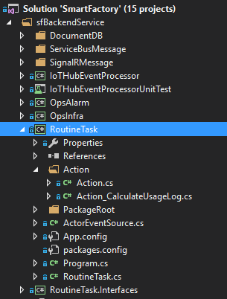
File Structure
Routine Task (Host)
Methods
StartHost
StartTask (Action1, Action2…)
Reminders
Calculate usage log
Send heart beat

Slide 9
Azure CosmosDB
Notes:
Message and alarm in no sql DB
Column f
Global distribution sync local db center
以前有人要自己去做這些事 現在透過設定就可以了
可以很聰明 例如你南美沒朋友 優先權就比較小
RU throughput

Slide 10
Introducing Azure Cosmos DB A globally distributed, massively scalable, multi-model database service
Automatically replicate all your data around the world – across more regions than Amazon and Google combined
Global distribution

Slide 11
Introducing Azure Cosmos DB A globally distributed, massively scalable, multi-model database service
Use key-value, graph, and document with a schema-agnostic service that doesn’t require any schema or secondary indexes
Global distribution
Multi-model + multi API
KEY-VALUE
COLUMN-FAMILY
DOCUMENT
GRAPH
Notes:
HBASE

Slide 12






Introducing Azure Cosmos DB A globally distributed, massively scalable, multi-model database service
Independently and elastically scale storage and throughput across regions
Global distribution
Multi-model + multi API
Elastic scale-out

Slide 13
Introducing Azure Cosmos DB A globally distributed, massively scalable, multi-model database service
Choose from five defined consistency levels for low latency and high availability
Global distribution
Multi-model + multi API
Elastic scale-out
Strong
Bounded-stateless
Session
Consistent prefix
Eventual
Choice of consistency

Slide 14
Introducing Azure Cosmos DB A globally distributed, massively scalable, multi-model database service
Serve <10 ms read and <15 ms write requests at the 99th percentile from the nearest region while delivering data globally
Global distribution
Multi-model + multi API
Elastic scale-out
Guaranteed global millisecond latency at the 99th percentile
Choice of consistency
Guaranteed single-digit latency

Slide 15
Introducing Azure Cosmos DB A globally distributed, massively scalable, multi-model database service
Only service with financially-backed SLAs for millisecond latency at the 99th percentile, 99.99% HA and guaranteed throughput and consistency
Global distribution
Multi-model + multi API
Latency
Throughput
Elastic scale-out
<10ms
HA
Consistency
Guaranteed
Choice of consistency
99th percentile
99.99%
Guaranteed
Guaranteed single-digit latency
Enterprise-level SLAs
Notes:
Only service with financially-backed SLAs for millisecond latency at the 99th percentile, 99.99% HA and guaranteed throughput and consistency
Text was: Access leading SLAs for latency at the 99th percentile, 99.99% HA, guaranteed throughput and consistency

Slide 16

DocumentDB
Azure DocumentDB Document store
{
"name": "John",
"country": "Canada",
"age": 43,
"lastUse": "March 4, 2014"
}
{
"name": "Eva",
"country": "Germany",
"age": 25
}
JSON
DOCUMENT 1
DOCUMENT 2
{
"name": "Lou",
"country": "Australia",
"age": 51,
"firstUse": "May 8, 2013"
}
{
"docCount": 3,
"last": "May 1, 2014"
}
Application
SQL query
DOCUMENT 3
DOCUMENT 4
Perfect for cloud architects and developers who need an enterprise-ready NoSQL document database
Notes:
So what is DocumentDB?
DocumentDB is a NoSQL document database-as-a-service, fully managed by Microsoft Azure.
It is a document-oriented, NoSQL database service designed for modern mobile and web applications.
DocumentDB delivers consistently fast reads and writes, schema flexibility, and the ability to easily scale a database up and down on demand. DocumentDB enables complex ad hoc queries using a dialect of SQL, supports well-defined consistency levels, and offers JavaScript language integrated, multidocument transaction processing using the familiar programming model of stored procedures, triggers and UDFs.

Slide 17
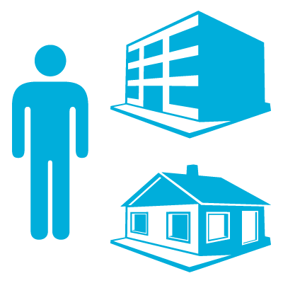
DocumentDB Architecture
Azure DocumentDB account
Company Id
Company Id
Databases
Collections
Documents
Attachments
{ }
101
010
{ }
Users
Stored procedures
Your documents here
JS
Permissions
Triggers
JS
User-defined functions
JS

Slide 18
DocumentDB Collections
Collections != tables
Unit of partitioning
Transaction boundary
No enforced schema, flexible
Queried or updated stay together in one collection
Partition : can span multiple partitions and support very large amounts of storage and throughput
RUs evenly distributed across partitions
Collections
Documents
Attachments
101
010
Stored procedures
Your documents here
JS
Triggers
JS
User-defined functions
JS
Notes:
SSD

Slide 19

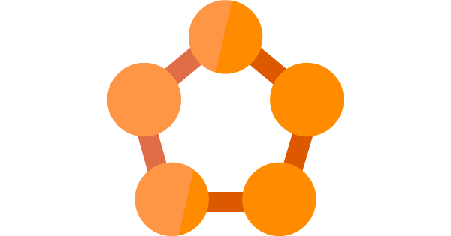
Related Service in Connected Device Studio
create/remove db & collection
Web Service
Restful API
Admin API
Device API
Service Fabric
Query document
OpsInfra
Cosmos DB (DocumentDB)
IoTHubReceiver
store telemetry & alarm document
RoutineTask
Query DocumentDB basic information & document

Slide 21
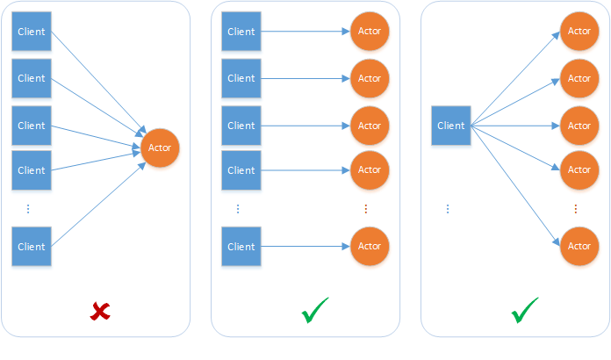
Reliable Actors
Service Fabric application framework based on the Virtual Actor pattern
Single-threaded programming
Actors
Isolated, independent unit of compute and state with single-threaded execution
Can communicate with each other and they can create more actors
Can schedule periodic work on themselves
Timers : The next period of the timer starts after the callback completes execution
Reminders : Similar to timers, but reminders are triggered under all circumstances
Notes:
provides a straightforward approach to building distributed interactive applications, without the need to learn complex programming patterns for handling concurrency, fault tolerance, and resource management.

Slide 22
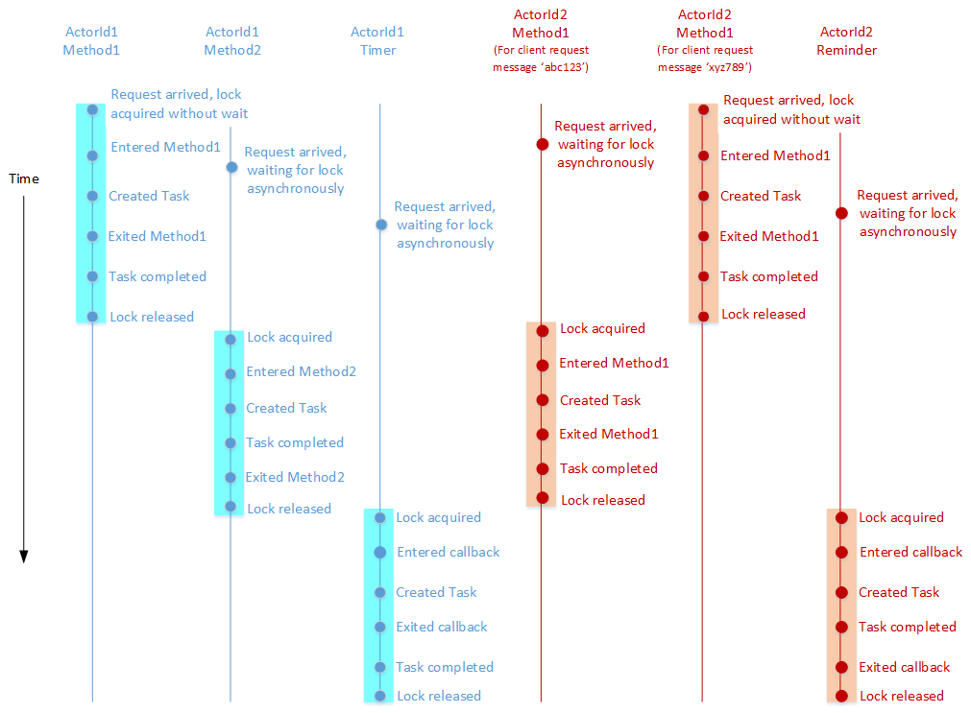
Example of concepts

Slide 23
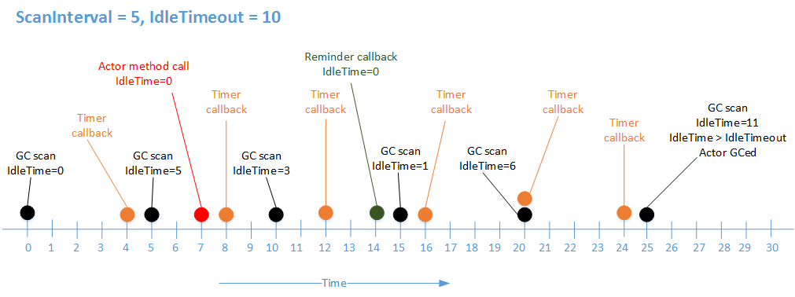
Actor Lifetime
Activated : the first time a call is made to any of its methods or reminder (not included timer).
Deactivated : if it is not used for a configurable period of time
Garbage collection : If actor be deactivated, actor object will be released. Its state have to be deleted manually.

